Slide 1
Media Description On Role Of Women In Nepal Transition
Name
Institution

Slide 2
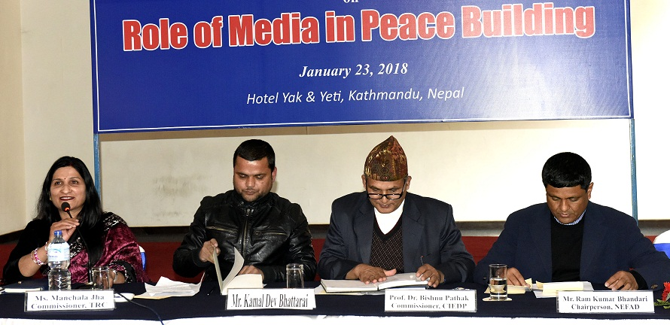
Introduction
Media plays a major role in influencing the perception of individuals within the society.
In cases where there is violence and conflict, the media can be used to control or enhance conflict.
Nepal has been in conflict for more than 10 years which is embracing transition.
The transition requires a highly developed based on the ability to manage the diverse peaceful outcomes.
mediaactionnepal.org

Slide 3
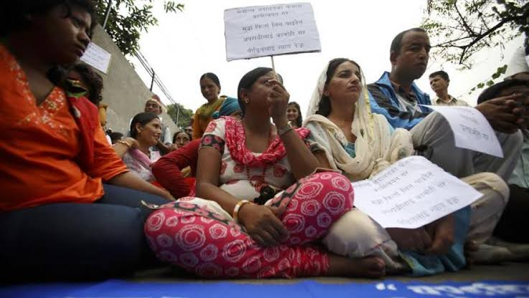
Introduction cont’d
Women have played a significant role in ensuring that the fragile unity that was developed is sustained through a more diverse approach.
The realization of the importance of women was a significant step taken to ensure that the transition period is successful for a country that has been in turmoil for more than ten years.
The media has been integral, especially considering how it has covered the influence of women leading to the end of the conflict in Nepal (Sthapit, 2015).
Human Rights Watch

Slide 4
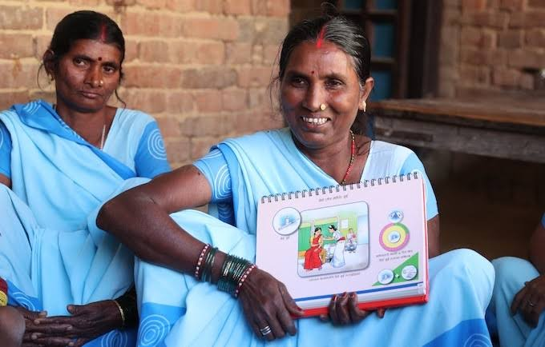
Media influence on role of women
In any post-conflict setting, media take center stage as being able to improve or give rise to chaos, depending on how they cover different events.
Creating a successful transition requires that media is onboard while ensuring that there is no bias coverage of events with a significant emphasis on peace messages.
Media is always targeted by various financiers to continue preaching hate messages.
However, a reliable system requires a free, fair, and just press that can identify and highlight real issues facing people throughout the country (Barrow, 2016).

Slide 5
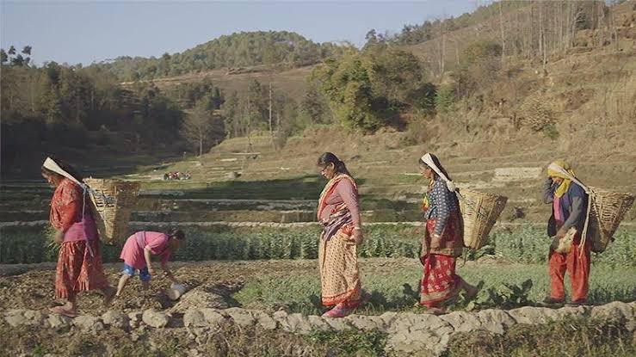
Media influence on role of women
The media has been integral to the success of peace missions in Nepal, especially considering how they have identified the role of women and different processes that can be regarded as in creating a strong focus on positive development rather than promoting divisions (Moosa, Rahmani and Webster, 2013).
Women play an integral role in any change process, especially in implementation, crisis management, post-conflict reintegration, and rehabilitation.
Women in Nepal have been bold enough to stand for what is right and help create a specific approach in improving the level of engagement among individuals.

Slide 6
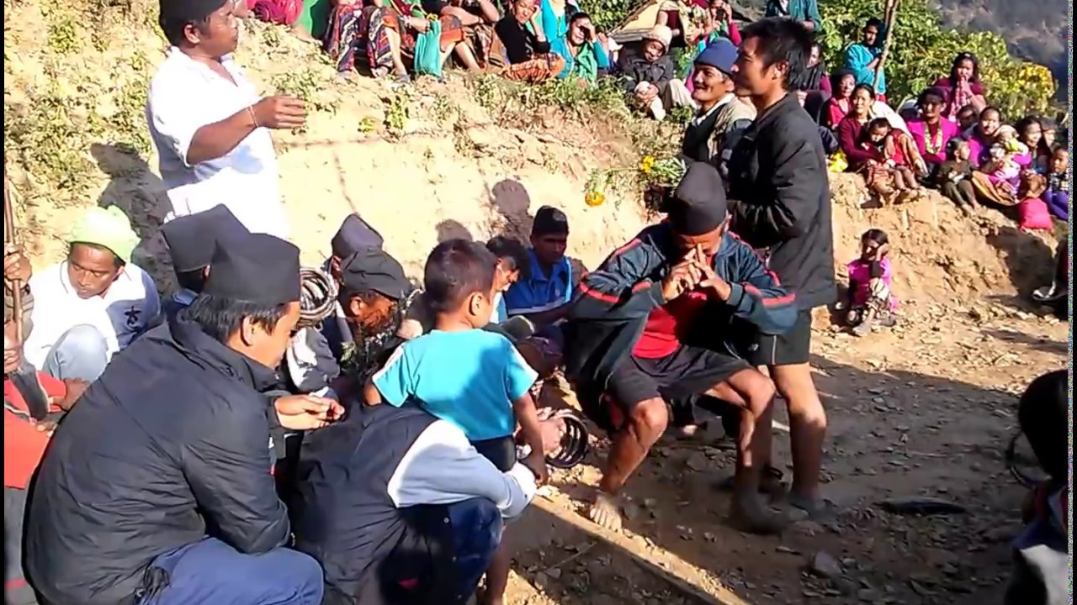
Media influence on role of women
The media has shown a strong performance among women in Nepal committed to ensuring a successful rehabilitation and reconstruction of the country.
The experiences of women and their roles in other war-torn countries have shown how strong women are and help in instigating the change process (Justino, Mitchell and Müller, 2018).

Slide 7
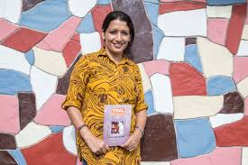
Media influence on role of women
The significant role of women in Nepal has been integral in the reconciliation process.
The reconciliation involves putting in place better strategies that help maintain a strong emphasis on essential concepts that help identify a better process that help focus on positive change within the communities.
Reconciliation thus involves searching for justice, healing forgiveness, and promoting peaceful coexistence (Barrow, 2016).

Slide 8
Media influence on role of women
Women peace campaigns have been organized throughout Nepal, focusing on ensuring that the needs of women and children are addressed in the development of better leadership structure within the communities (Shekhawat, 2015).
Thus facilitating conflict resolution measures has been an essential focus that improves the underlying measures that were being assessed in enhancing the overall commitment to improving the wellbeing of members in the society.
Reintegration is a complicated process, especially after a long time of conflict, people are still hurt by the actions of their neighbors hence are less willing to forgive and move forward. The role of women is integral to the success of the transition process.

Slide 9
Media influence on role of women
The current transitional situation of Nepal gives women significant roles and opportunities.
This is essential in helping create a more diverse understanding of specific policies and processes that are implemented in improving the overall assessment of better elements that define a secure change process.
Women were associated with participation in implementing better procedures that seek to create a more focus on socio-economic reforms.
Empowerment activities were also linked to the role of women, which helped define a strong emphasis on better measures that describe the change process.(Justino, Mitchell and Müller, 2018)

Slide 10
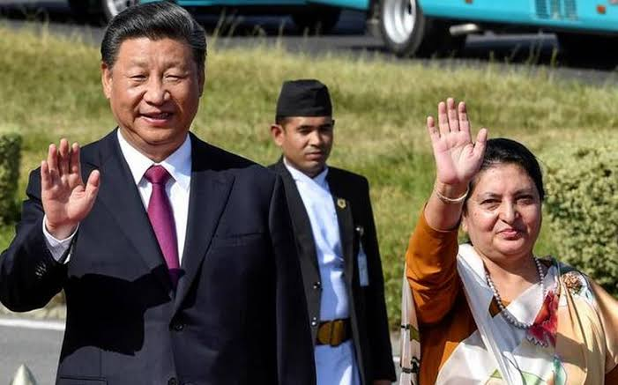
Media influence on role of women
The increasing focus on the role of women within the society provided a more significant commitment within the organization, which helped build a united front that included the need of all stakeholders.
The political and socio-economic transformation has been a considerable emphasis on the needs of individuals within society.
Creating a favorable environment where the change process can be improved helps define a secure change process that maintains an improved emphasis on changing key elements that define societal changes (Anderson and Swiss, 2014).

Slide 11
Conclusion
Media has been integral in promoting the increased role of women in building relationships in Nepal.
Women and children are the most affected in cases of conflict.
Therefore women have a higher knowledge of better processes that help define better change processes.
The media has been integral in empowering women through highlighting some of the critical elements that can be considered in improving the overall management of diverse concepts in enhancing the overall development of better processes that define successful engagement.

Slide 12
References
Anderson, M. J. and Swiss, L. (2014) ‘Peace accords and the adoption of electoral quotas for women in the developing world, 1990-2006’, Politics and Gender. doi: 10.1017/S1743923X13000536.
Barrow, A. (2016) ‘Operationalizing Security Council Resolution 1325: The role of National Action Plans’, Journal of Conflict and Security Law. doi: 10.1093/jcsl/krw002.
Justino, P., Mitchell, R. and Müller, C. (2018) ‘Women and Peace Building: Local Perspectives on Opportunities and Barriers’, Development and Change. doi: 10.1111/dech.12391.
Moosa, Z., Rahmani, M. and Webster, L. (2013) ‘From the private to the public sphere: New research on women’s participation in peace-building’, Gender and Development. doi: 10.1080/13552074.2013.846585.
Shekhawat, S. (2015) Female combatants in conflict and peace: Challenging gender in violence and post-conflict reintegration, Female Combatants in Conflict and Peace: Challenging Gender in Violence and Post-Conflict Reintegration. doi: 10.1057/9781137516565.
Sthapit, C. W. (2015) ‘Gendered impacts of the earthquake and responses in Nepal’, Feminist Studies. doi: 10.15767/feministstudies.41.3.682.

